Slide 1
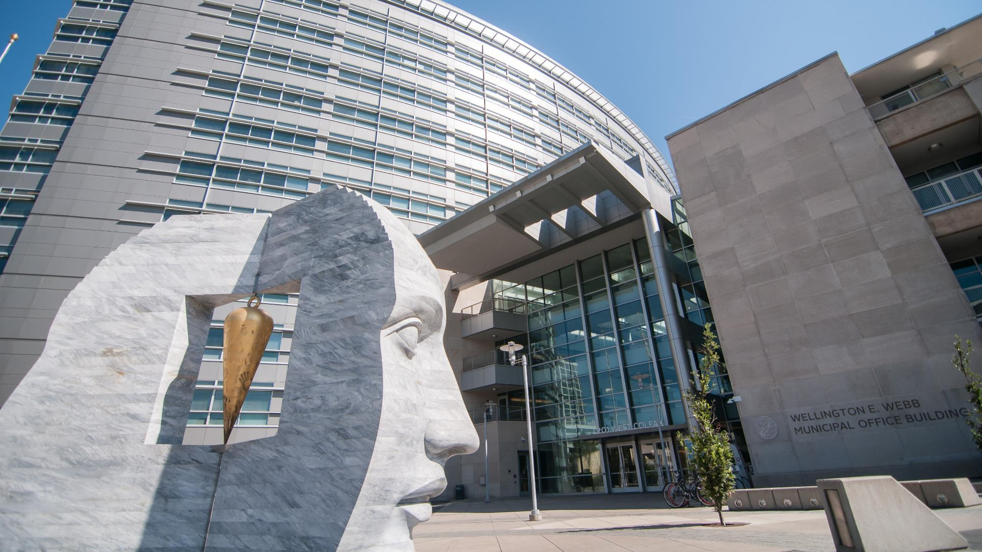
Denver Auditor
Timothy M. O’Brien, CPA

Slide 2
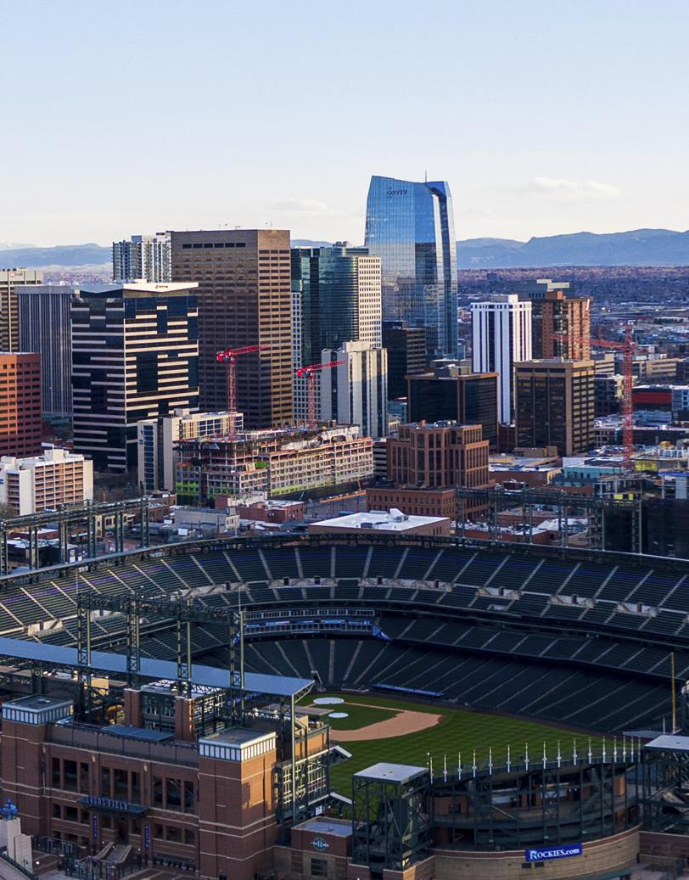
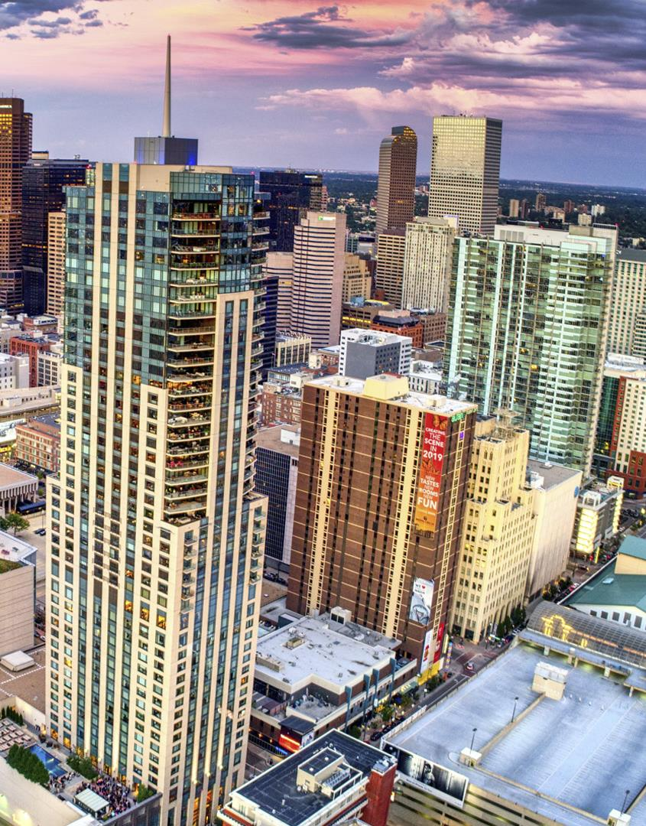
Mountain Plains Intergovernmental Audit Forum
Auditing Affordable Housing & Encampment Response
Kharis Eppstein, CIA, CGAP, Audit Manager
Chris Wilson, MPA, Audit Analytics Manager
Tyson Faussone, CIA, Lead Auditor
TIMOTHY M. O’BRIEN, CPA, AUDITOR
TIMOTHY M. O’BRIEN, CPA, AUDITOR

Slide 3
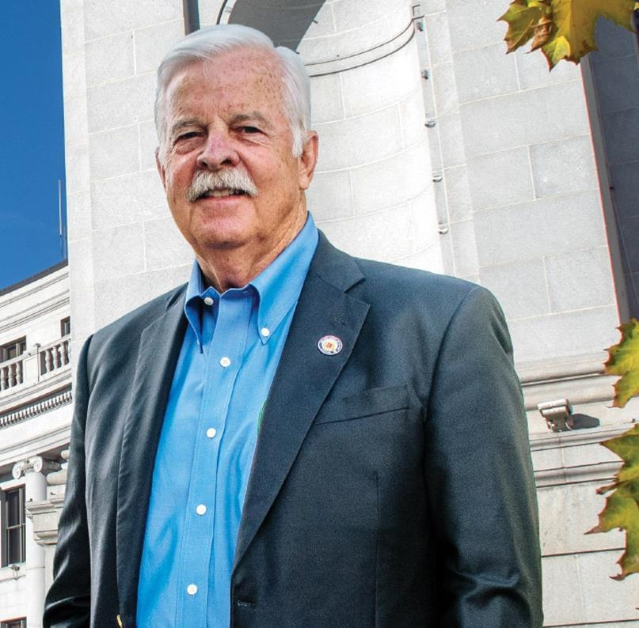
AUDITOR O’BRIEN
Timothy M O’Brien was elected as the 24th Auditor of the City and County of Denver in 2015 and was re-elected in 2019 and 2023.
TIMOTHY M. O’BRIEN, CPA, AUDITOR

Slide 4
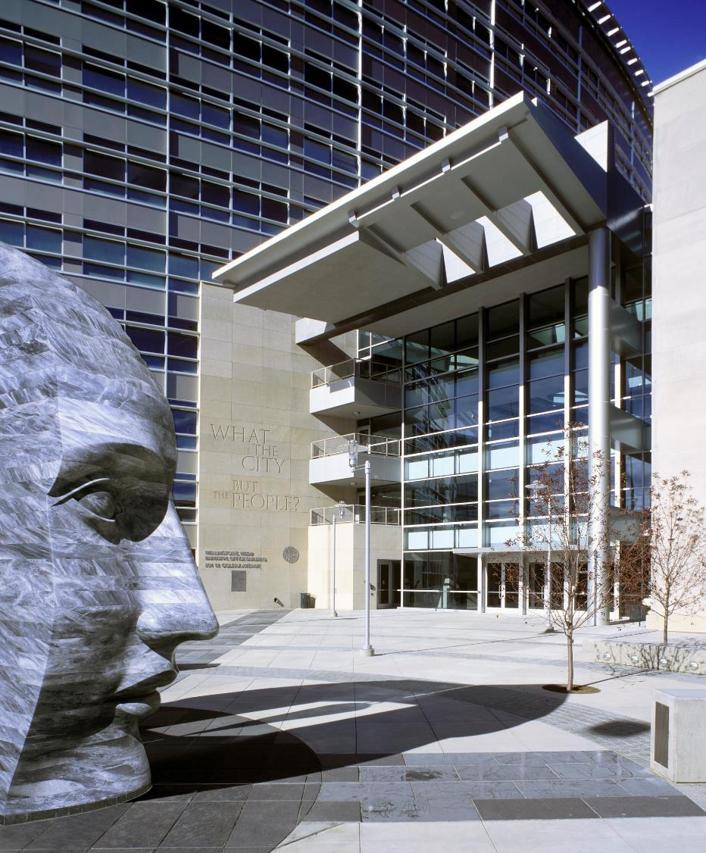
PANEL DISCUSSION AGENDA
Considering the issues.
Evaluating the data.
Assessing who to audit.
Managing difficult audits.
Working with third-parties.
Identifying criteria and leading practices.
TIMOTHY M. O’BRIEN, CPA, AUDITOR
TIMOTHY M. O’BRIEN, CPA, AUDITOR

Slide 5
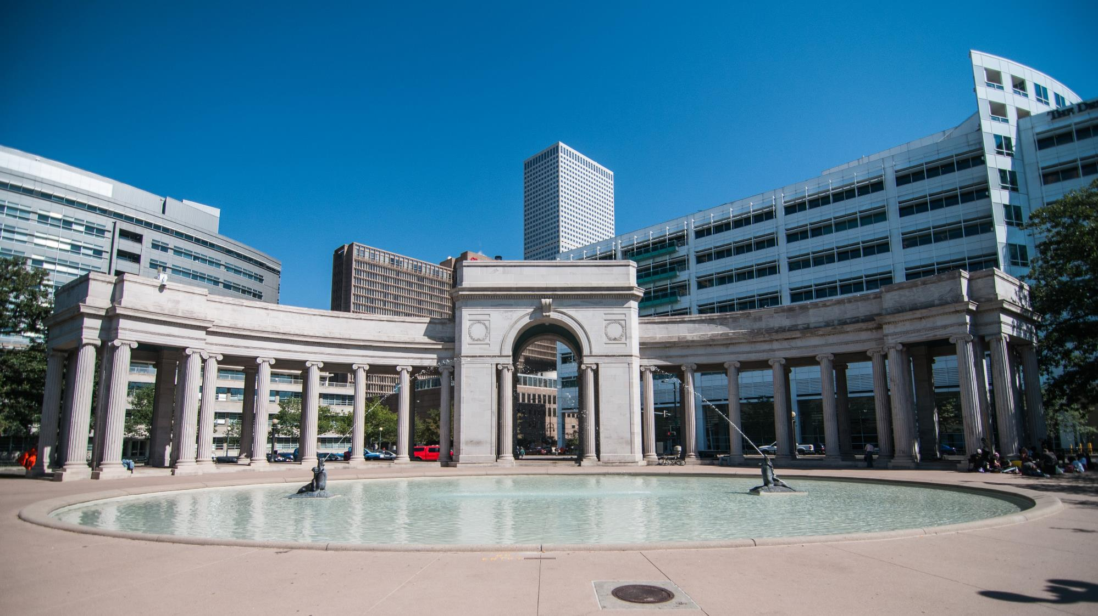
CONSIDERING
THE
ISSUES

Slide 6
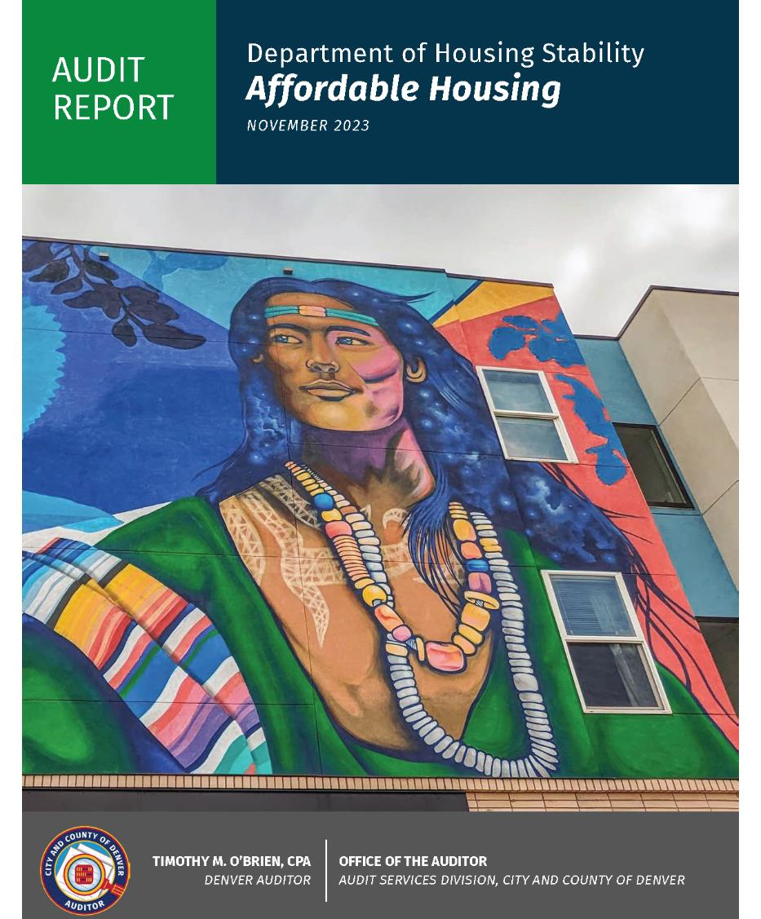
CONSIDERING THE ISSUES
Affordable housing development.
Developer interest and market conditions.
Funding sources and permitted uses.
Measuring return on investment.
TIMOTHY M. O’BRIEN, CPA, AUDITOR

Slide 7
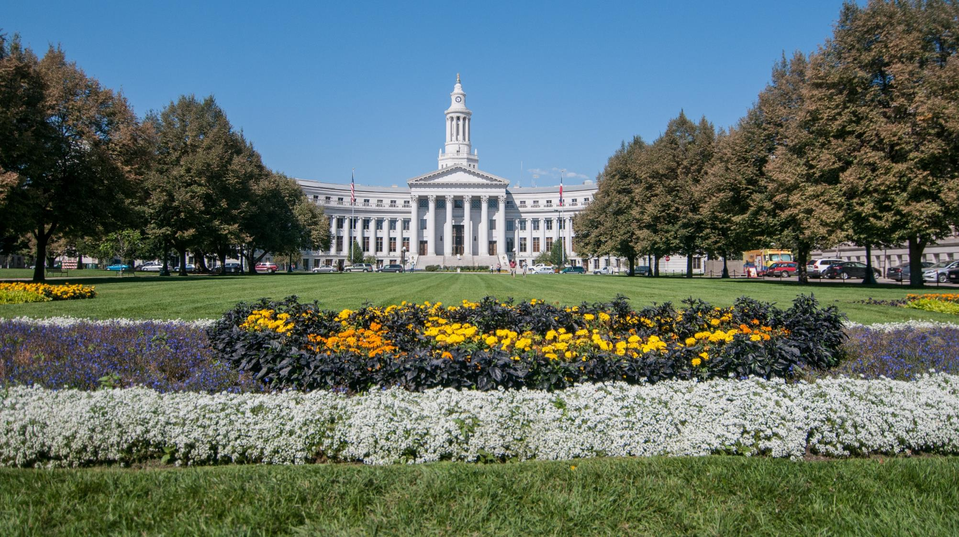
CONSIDERING THE ISSUES
2017 ACTUALS
Housing Project | Address | Restricted Units Remaining | Tenure Type | Project Status | Funding Source | Funding Amount | Affordability Source | Coordinates (Latitude) | Coordinates (Longitude)
Riverstone Heights | 123 Oakwood Drive | 7 | Rental | Constructed & Open | Unknown |  | AS-00649 | 39.947829 | -104.217104
Cedar Ridge Estates | 202 Cedar Lane | 103 | Rental | Constructed & Open | Dedicated Housing Fund Linkage Fee | $3,700,000.00 | AS-00422 | 39.366664 | -104.526583
Sierra Verde Estates | 789 Pine Crescent | 21 | Rental | Ready for Occupancy | Skyline | $11,000,000.00 | AS-00218 | 39.511639 | -104.397678
Residencias del Sol | 101 Birch Avenue | 54 | Rental | Constructed & Open | HOME | $4,538,460.32 | AS-00344 | 39.703199 | -105.868252
Villas de la Esperanza | 303 Elm Road | 71 | Rental | Constructed & Open | HOME | $6,645,194.56 | AS-00336 | 39.306276 | -105.265783
Lakeside Commons | 404 Willow Boulevard | 1 | Rental | Constructed & Open | CDBG | $14,815,237.37 | AS-00350 | 39.146048 | -105.052669
Parkside Terraces II | 505 Cherry Court | 90 | Rental | Constructed & Open | Dedicated Housing Fund Property Tax | $21,910,181.00 | AS-00417 | 39.168373 | -104.177885
Parkside Terraces III | 505 Cherry Court | 127 | Rental | Constructed & Open | Dedicated Housing Fund Property Tax | $21,910,181.00 | AS-00417 | 39.545414 | -104.222005
TIMOTHY M. O’BRIEN, CPA, AUDITOR
Source: Auditor’s Office Staff using modified data from Housing Stability.

Slide 8
CONSIDERING THE ISSUES
Affordable housing preservation.
Covenants define affordability and specify requirements.
Preserve affordable housing units by preventing foreclosures and extending covenants.
TIMOTHY M. O’BRIEN, CPA, AUDITOR

Slide 9
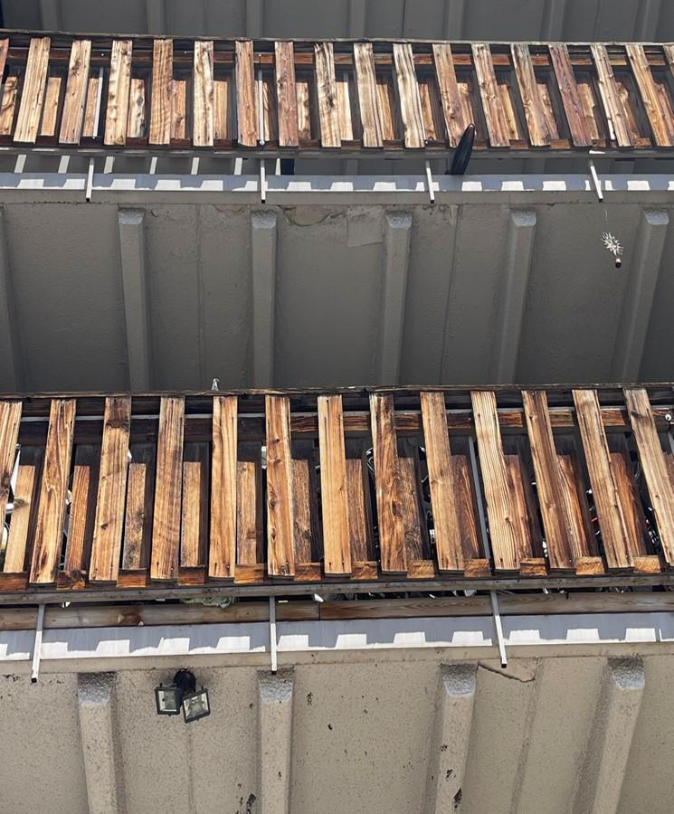
CONSIDERING THE ISSUES
Housing quality standards.
Federal guidelines and local ordinance establish standards and responsibilities of property-owners and residents.
Conduct onsite observations of exterior and interior public spaces.
Compare observations with agency inspection results.
TIMOTHY M. O’BRIEN, CPA, AUDITOR
TIMOTHY M. O’BRIEN, CPA, AUDITOR

Slide 10
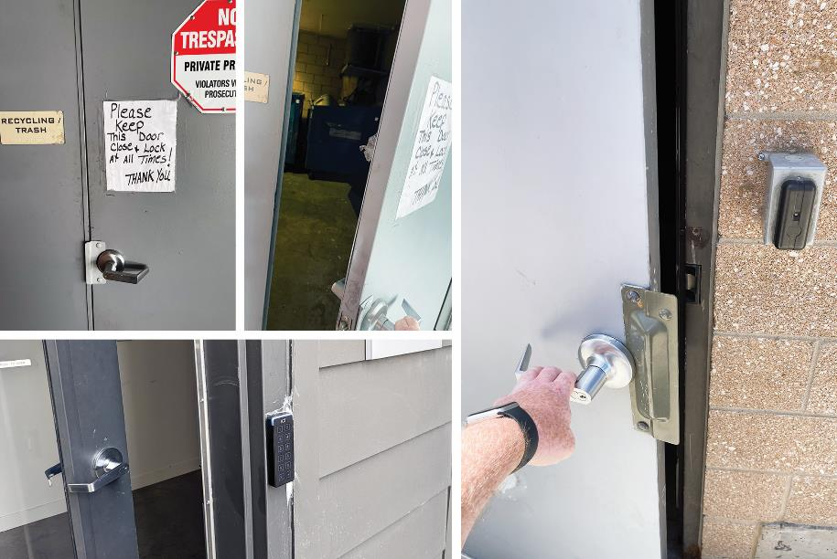
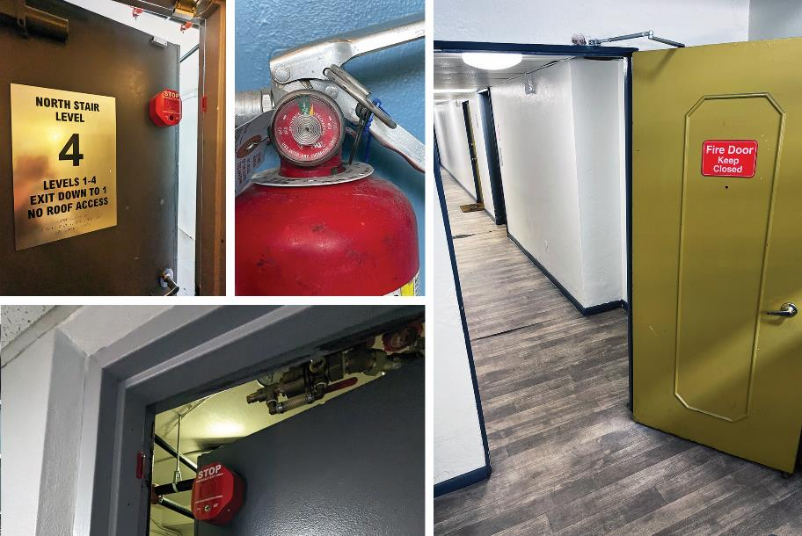
ISSUES FOUND BY AUDITORS
2017 ACTUALS
TIMOTHY M. O’BRIEN, CPA, AUDITOR
Source: Photos by Auditor’s Office Staff of unsecured doors and fire safety risks.
Source: Created by Auditor’s Office staff using information from the Colorado Coalition for the Homeless, Denver Department of Housing Stability, and the U.S. Department of Housing and Urban Development.

Slide 11
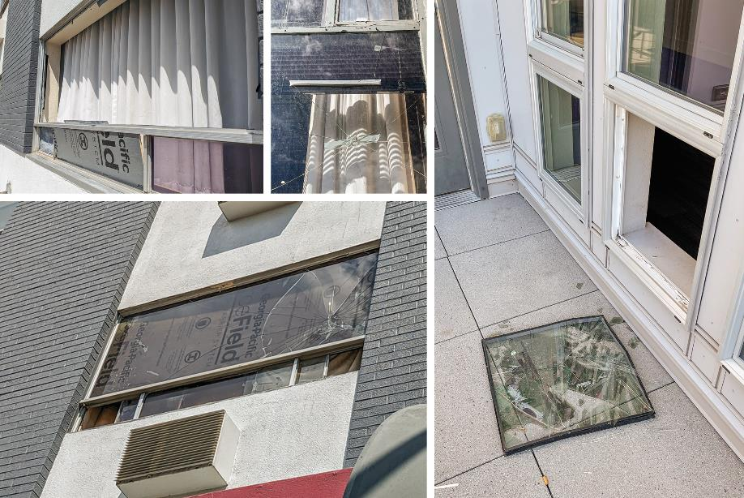
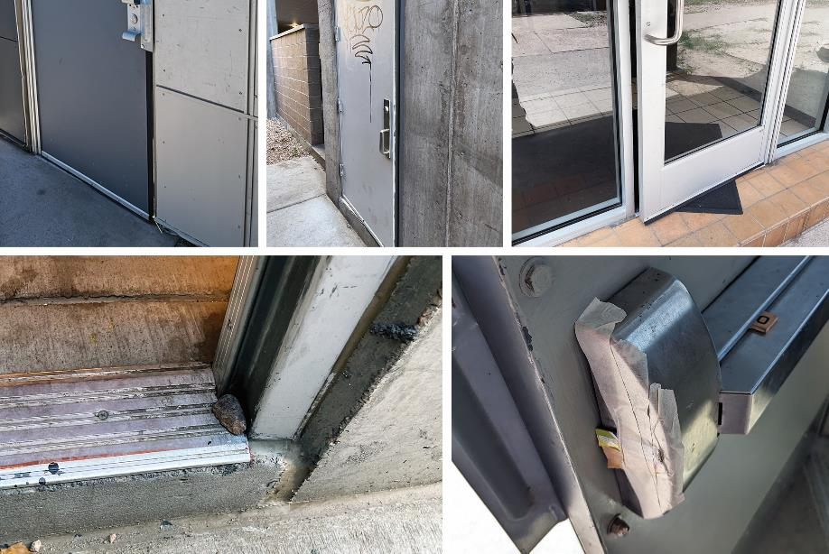
ISSUES FOUND BY AUDITORS
2017 ACTUALS
TIMOTHY M. O’BRIEN, CPA, AUDITOR
Source: Photos by Auditor’s Office Staff of tampered doors and broken windows..
Source: Created by Auditor’s Office staff using information from the Colorado Coalition for the Homeless, Denver Department of Housing Stability, and the U.S. Department of Housing and Urban Development.

Slide 12
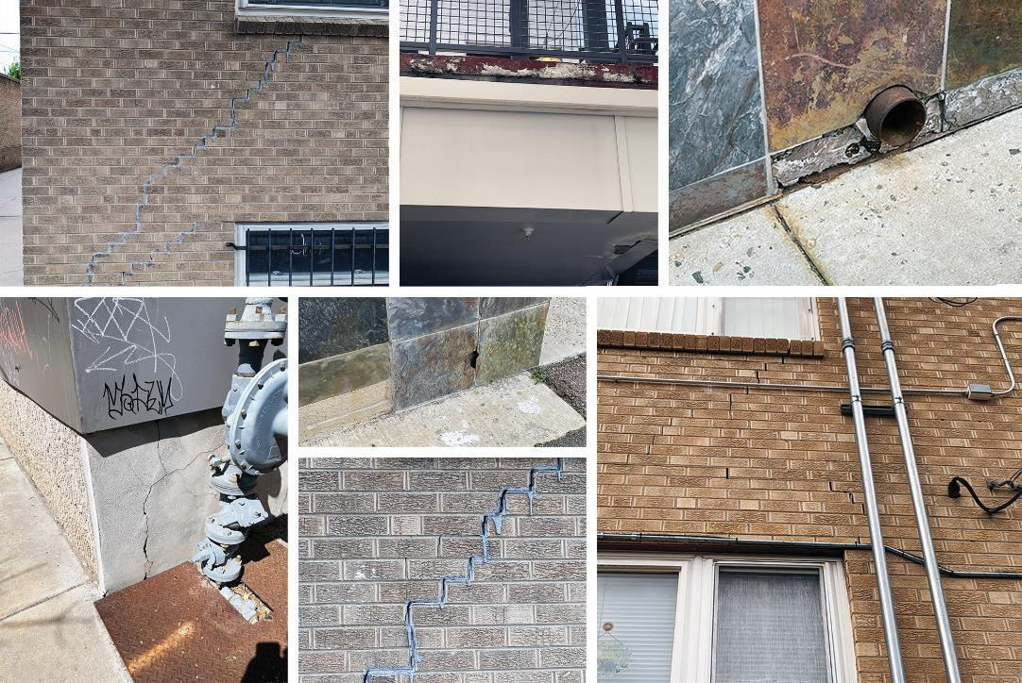
ISSUES FOUND BY AUDITORS
2017 ACTUALS
TIMOTHY M. O’BRIEN, CPA, AUDITOR
Source: Photos by Auditor’s Office Staff of damaged and cracked exterior walls.
Source: Created by Auditor’s Office staff using information from the Colorado Coalition for the Homeless, Denver Department of Housing Stability, and the U.S. Department of Housing and Urban Development.

Slide 13
CONSIDERING THE ISSUES
Income verification.
Annual requirement to provide number of residents in units and incomes.
Staff capacity and processes for independent on-site and virtual audits.
Risk with reliance upon information submitted by property managers.
Units may not be available for people who need them.
TIMOTHY M. O’BRIEN, CPA, AUDITOR
TIMOTHY M. O’BRIEN, CPA, AUDITOR

Slide 14
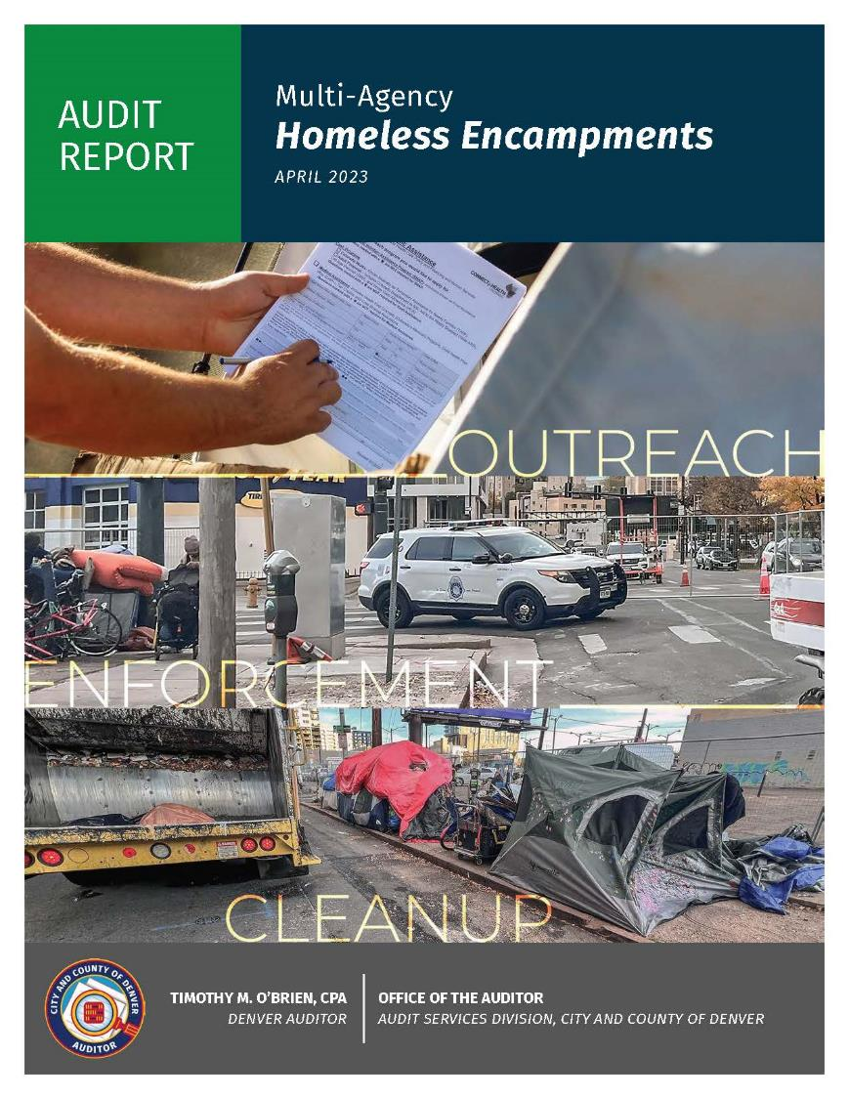
CONSIDERING THE ISSUES
Encampment response.
Equity in services provided; including communication from city agencies.
Equity in city processes.
Compliance with laws, rules and regulations, and settlement agreements.
Support services, such as storage of personal items.

Slide 15
ENCAMPMENT LOCATION DATA
2017 ACTUALS
HOMELESSNESS SERVICES
 | A | B | C | D
1 | Date | Posting | Cleanup Address | Cleanup Conducted
2 | 1/4/2022 | 11th and Colfax | 11th and 12th & Colfax | Complete
3 | 1/4/2022 | City Park | 17th and Park/18th and Park | Complete
4 | 1/5/2022 | 7th and Emerson | 6th and Logan/7th and Emerson | Cancelled
5 | 1/5/2022 | 20th and Glenarm | 16th and Glenarm | Complete
TIMOTHY M. O’BRIEN, CPA, AUDITOR
Source: Auditor’s Office analysis of data from the Mayor’s Office.

Slide 16
ENCAMPMENT LOCATION DATA, CONTINUED
2017 ACTUALS
HOMELESSNESS SERVICES
 | A | B | C | D | E
1 | Date | Posting | Cleanup Address | Cleanup Conducted | Latitude/Longitude
2 | 1/4/2022 | 11th and Colfax | 11th and 12th & Colfax | Complete | 39.752355074063004, -104.98841972374275
3 | 1/4/2022 | City Park | 17th and Park/18 and Park | Complete | 39.754833891567415, -104.97312117535854
4 | 1/5/2022 | 7th and Emerson | 6th and Logan/7th and Emerson | Cancelled | 39.754784398732205, -104.95982540847518
5 | 1/5/2022 | 20th and Glenarm | 16th and Glenarm | Complete | 39.73299180470635, -104.97040252435491
TIMOTHY M. O’BRIEN, CPA, AUDITOR
Source: Auditor’s Office analysis of data from the Mayor’s Office.

Slide 17
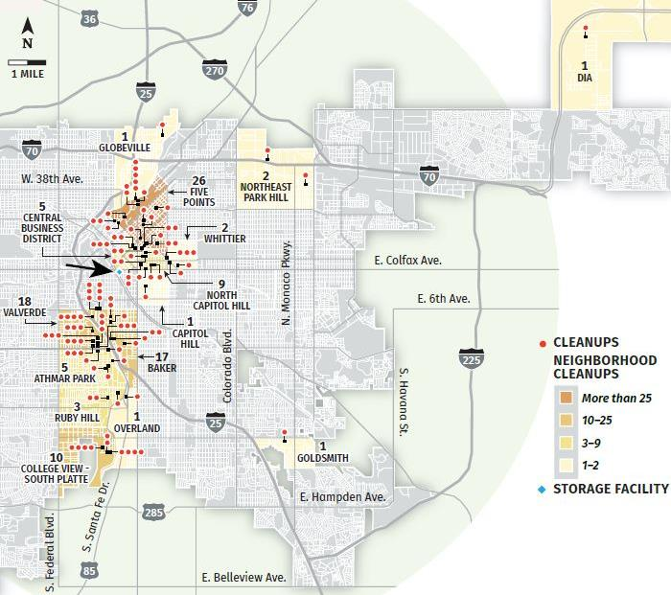
ENCAMPMENT LOCATION DATA, CONTINUED
2017 ACTUALS
HOMELESSNESS SERVICES
Encampment cleanups and the property storage facility, January 2022 through June 2022.
TIMOTHY M. O’BRIEN, CPA, AUDITOR
Source: Auditor’s Office analysis of data from the Mayor’s Office.
Notes:
NOTE: Green arrows are to highlight the furthest encampments from the storage facility identified by the blue arrow. This illustrates the inequity in support services.

Slide 18
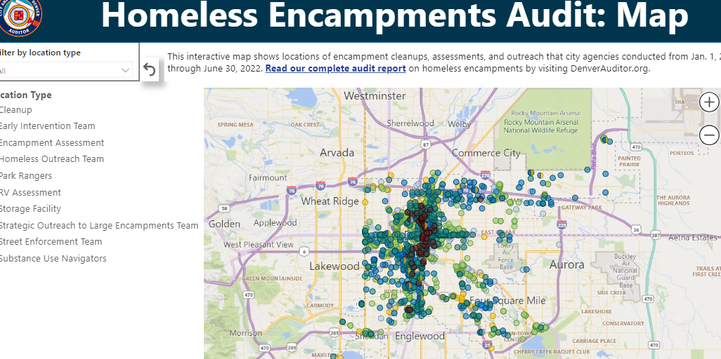
2017 ACTUALS
HOMELESSNESS SERVICES
TIMOTHY M. O’BRIEN, CPA, AUDITOR
Source: Auditor’s Office analysis of data from Public Health and Environment, Housing Stability, Public Safety, and Police .

Slide 19
EVALUATING THE
DATA

Slide 20
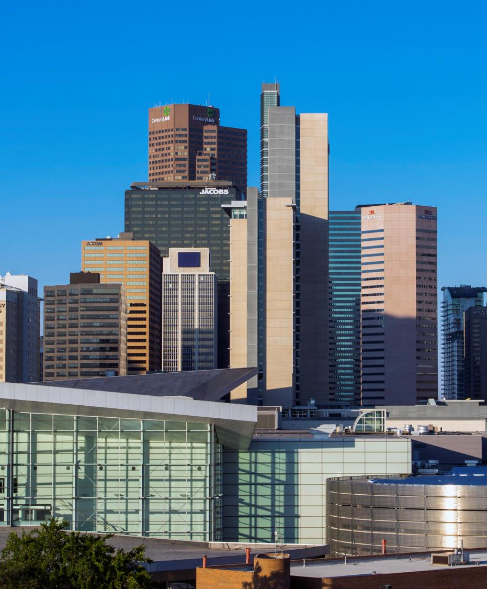
DATA CONSIDERATIONS
Available data types, sources, systems, and existing controls.
Assessing data reliability.
Analyses of data quality, completeness, and accuracy.
Normalizing data for analysis.
TIMOTHY M. O’BRIEN, CPA, AUDITOR
TIMOTHY M. O’BRIEN, CPA, AUDITOR

Slide 21
DATA CONSIDERATIONS
Selecting a testing methodology.
Entire populations using computer-aided tools.
Manual tests using statistical and judgmental sampling.
TIMOTHY M. O’BRIEN, CPA, AUDITOR
TIMOTHY M. O’BRIEN, CPA, AUDITOR

Slide 22
ASSESSING
WHO TO
AUDIT

Slide 23
WHO TO AUDIT
Affordable Housing:
Housing Stability has a primary role, but it’s complicated.
Mayor’s Office.
City Attorney’s Office.
Public Health and Environment.
Human Services.
County Assessor.
TIMOTHY M. O’BRIEN, CPA, AUDITOR
TIMOTHY M. O’BRIEN, CPA, AUDITOR

Slide 24
WHO TO AUDIT
Encampment Response:
10 agencies in the City and County of Denver are responsible for encampment response.
Mayor’s Office.
City Attorney’s Office.
Public Health and Environment.
Transportation & Infrastructure.
Parks and Recreation.
Housing Stability.
Public Safety.
Police.
Fire.
Human Services.
TIMOTHY M. O’BRIEN, CPA, AUDITOR
TIMOTHY M. O’BRIEN, CPA, AUDITOR

Slide 25
MANAGING
DIFFICULT AUDITS

Slide 26
DIFFICULT AUDITS
Newly developed policies may lack clarity.
Newly formed agencies or undergoing significant change.
Expanding agency and staff responsibilities.
Heightened public awareness and differing perspectives.
Stakeholder expectations and interpretations.
TIMOTHY M. O’BRIEN, CPA, AUDITOR
TIMOTHY M. O’BRIEN, CPA, AUDITOR

Slide 27
DIFFICULT AUDITS
Auditing hard topics.
Auditors may observe encampments, drug abuse, body camera footage, and unsafe housing conditions.
Auditors may interact with individuals in crisis and families in need.
Explaining hard topics.
Balancing objective reporting and what is appropriate to share publicly.
TIMOTHY M. O’BRIEN, CPA, AUDITOR
TIMOTHY M. O’BRIEN, CPA, AUDITOR

Slide 28
WORKING WITH THIRD-PARTIES

Slide 29
WORKING WITH THIRD-PARTIES
Adequacy of agency oversight.
Fulfillment of reporting requirements.
Compliance with terms of agreement.
Efficient and effective use of resources.
TIMOTHY M. O’BRIEN, CPA, AUDITOR
TIMOTHY M. O’BRIEN, CPA, AUDITOR

Slide 30
WORKING WITH THIRD-PARTIES
Third-parties may misinterpret that they are the auditee.
Fear of reputational damage.
Agencies may have existing relationships.
Access to information may be hindered or delayed.
TIMOTHY M. O’BRIEN, CPA, AUDITOR
TIMOTHY M. O’BRIEN, CPA, AUDITOR

Slide 31
IDENTIFYING
CRITERIA & LEADING PRACTICES

Slide 32
CRITERIA & LEADING PRACTICES
Terms of agreements.
Policy goals defined by agencies and decision makers.
Funding restrictions such as permitted uses or investment allocation.
State and local legislation.
TIMOTHY M. O’BRIEN, CPA, AUDITOR
TIMOTHY M. O’BRIEN, CPA, AUDITOR

Slide 33
CRITERIA & LEADING PRACTICES
Federal agency guidance and requirements:
Department of Housing and Urban Development.
Homeless Policy Research Institute.
U.S. Interagency Counsel on Homelessness.
Agencies providing point-in-time counts of those experiencing homelessness.
Benchmarking.
TIMOTHY M. O’BRIEN, CPA, AUDITOR
TIMOTHY M. O’BRIEN, CPA, AUDITOR

Slide 34
KEY TAKEAWAYS
Identify and understand key challenges and the agencies that may have a role.
Consider phased audits to evaluate broader risks.
Focus upon a systematic, data-driven, and collaborative approach.
Evaluate disparate data sources to illustrate more comprehensive risks, efforts, and impacts.
TIMOTHY M. O’BRIEN, CPA, AUDITOR

Slide 35
THANK YOU! QUESTIONS?
Denver Auditor’s Office
DenverAuditor.org
auditor@denvergov.org
720-913-5000
Facebook.com/DenverAuditorOBrien

