Slide 1
CALIFORNIA STATE AUDITOR
Auditing State and Local Homelessness Programs
Nicholas Kolitsos, CPA, Audit Principal
Chris Paparian, Senior Auditor
Live Virtual – WIAF | September 11, 2024

Slide 2
Webinar Topics
Audit Request and Planning
Methodology for Evaluating the State
Methodology for Evaluating Local Governments

Slide 3
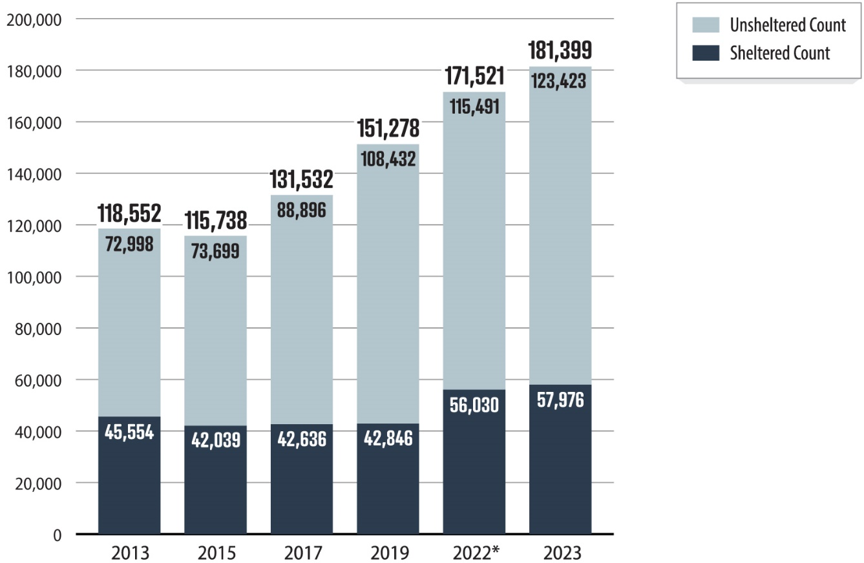
Audit Request and Planning
Homelessness in CA increased in recent years…
…and the State spent $24 billion to address.

Slide 4
Audit Request and Planning
Interim Housing
Effectiveness
Local Funding
Demographic Disparities
Health and Safety
Strategic Planning
Siting
Data Sharing
State Funding
State Oversight
Privacy
Contract Management
Permanent Housing
Administrative Costs
Federal Funding
Staffing
Local Accountability
Timing
Cost Effectiveness
Goals and Outcomes

Slide 5
Audit Request and Planning
State
Two Cities

Slide 6
Methodology for Evaluating the State
Objectives
Audit objectives covered two key aspects of the State’s homelessness efforts:
Strategic planning
Cost effectiveness

Slide 7
Methodology for Evaluating the State
Strategic Planning
California’s Interagency Council on Homelessness is responsible for strategic planning
The Legislature provides funding to programs and local governments to address homelessness

Slide 8
Methodology for Evaluating the State
Strategic Planning

Slide 9
Methodology for Evaluating the State
Strategic Planning
At the time of our audit Cal ICH did not regularly collect and report on:
Program costs and the associated outcomes for people experiencing homelessness

Slide 10
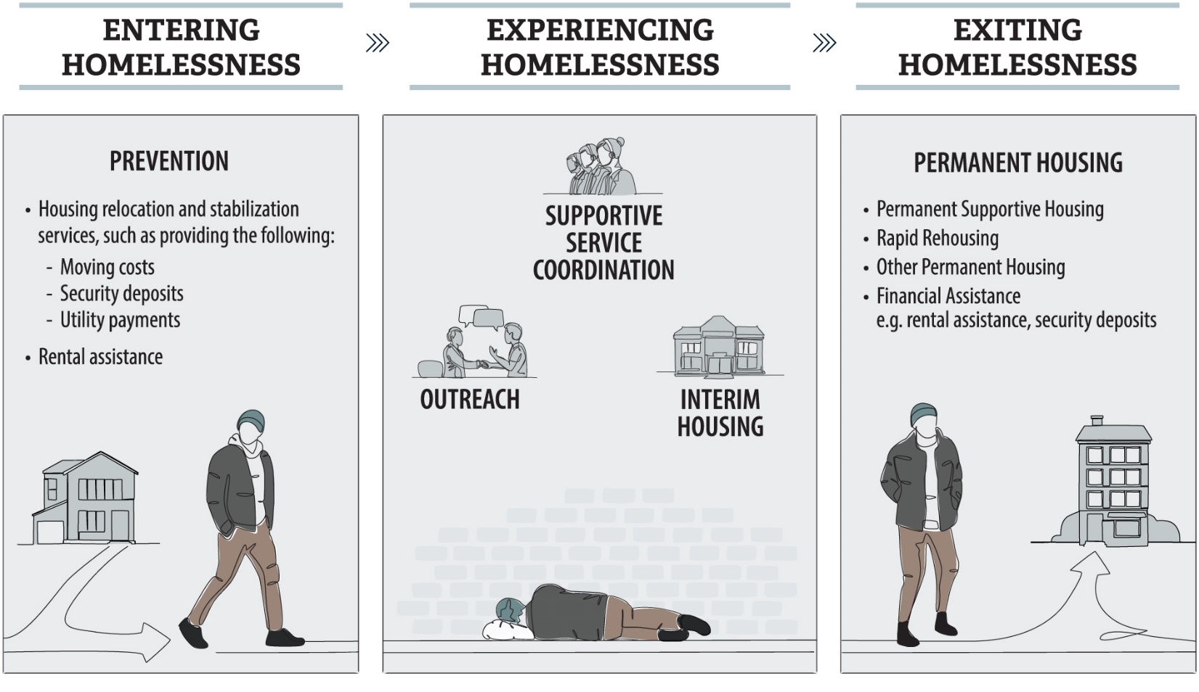
Methodology for Evaluating the State
Cost Effectiveness

Slide 11
Methodology for Evaluating the State
Cost Effectiveness
Prevention Programs
CalWORKS Housing Support Program
Emergency Rental Assistance Program
Outreach, Safety, and Interim Housing Programs
Encampment Resolution Funding
Permanent Housing Programs
Homekey
Homeless Housing, Assistance and Prevention Program (covers all three)

Slide 12
Methodology for Evaluating the State
Cost Effectiveness
Two Categories of Programs:
Insufficient data to assess cost effectiveness
Likely cost effective

Slide 13
Methodology for Evaluating the State
Cost Effectiveness
Three programs lacked sufficient data to assess cost effectiveness:
Encampment Resolution Funding
Homeless Housing, Assistance and Prevention
Emergency Rental Assistance

Slide 14
Methodology for Evaluating the State
Cost Effectiveness
Calworks HSP
Homekey

Slide 15
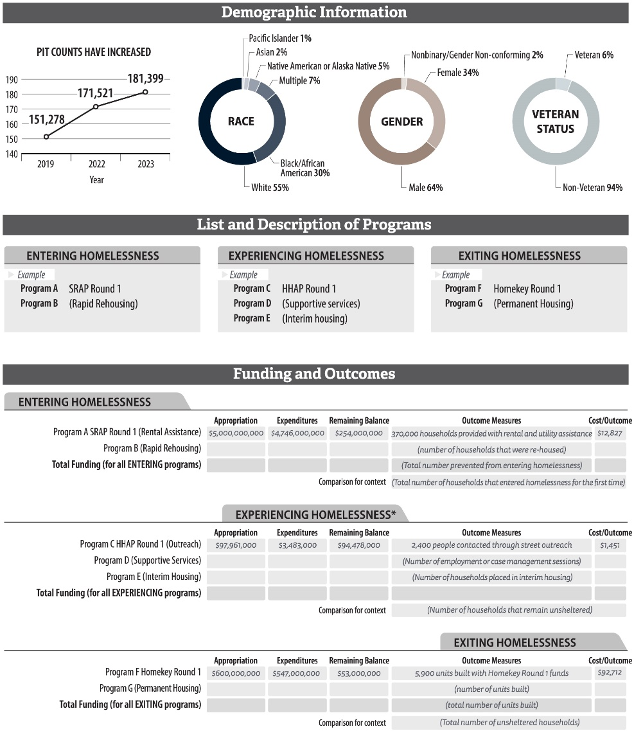
Methodology for Evaluating the State
State Recommendations
Scorecard
Improving Data Quality
Reporting on Costs and Outcomes (Pending Legislation)

Slide 16
Methodology for Evaluating Local Governments
Selection

Slide 17
Methodology for Evaluating Local Governments
Objectives
Audit objectives covered many aspects of the cities’ homelessness efforts including:
Finances
Effectiveness
Housing

Slide 18
Methodology for Evaluating Local Governments
Funding and Tracking
Difficulties gathering comprehensive funding information:
Lack of Consistency Between Departments
Comingling of Funds
No Spending Plan

Slide 19
Methodology for Evaluating Local Governments
Funding and Tracking
Sources of information gathered to compile homelessness funding information:
Approved Budgets
Federal and State Grant Award Letters
City Accounting Records
Contracts with Nonprofits

Slide 20
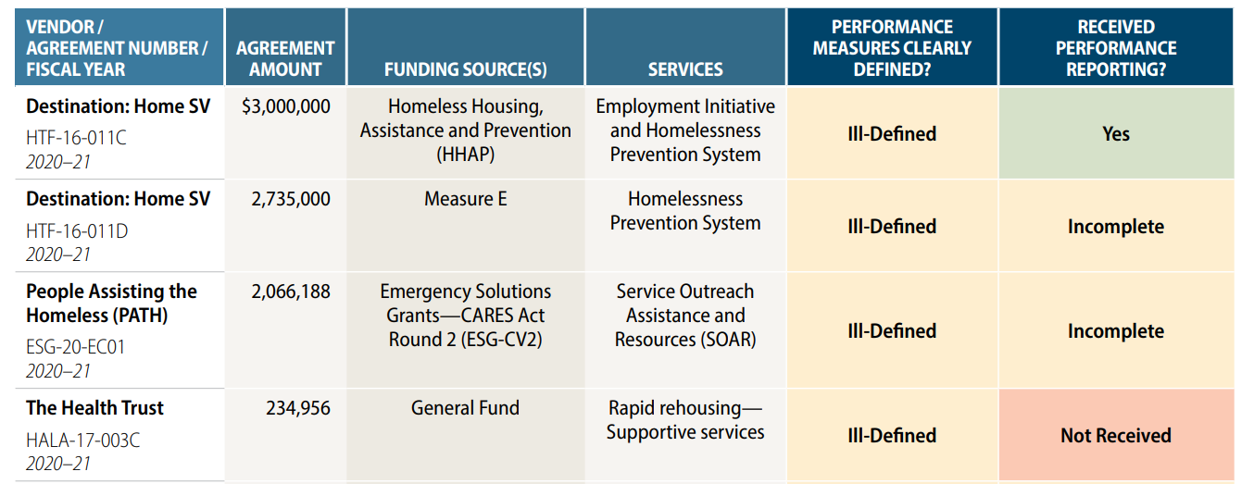
Methodology for Evaluating Local Governments
Effectiveness
Contracts with Nonprofits:

Slide 21
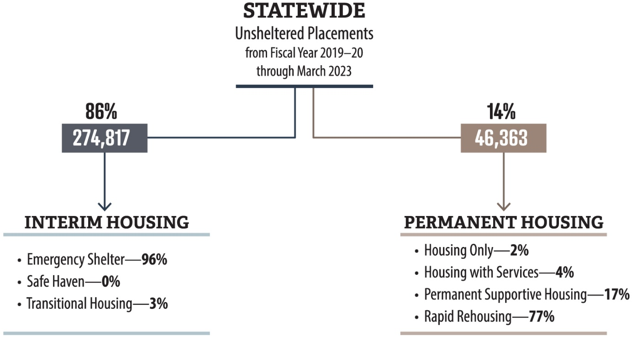
Methodology for Evaluating Local Governments
Housing

Slide 22
Methodology for Evaluating Local Governments
Local Recommendations
Track and report financial information
Improved contract management to focus on effectiveness
Planning for housing needs

Slide 23
Questions?
Text

