Slide 1
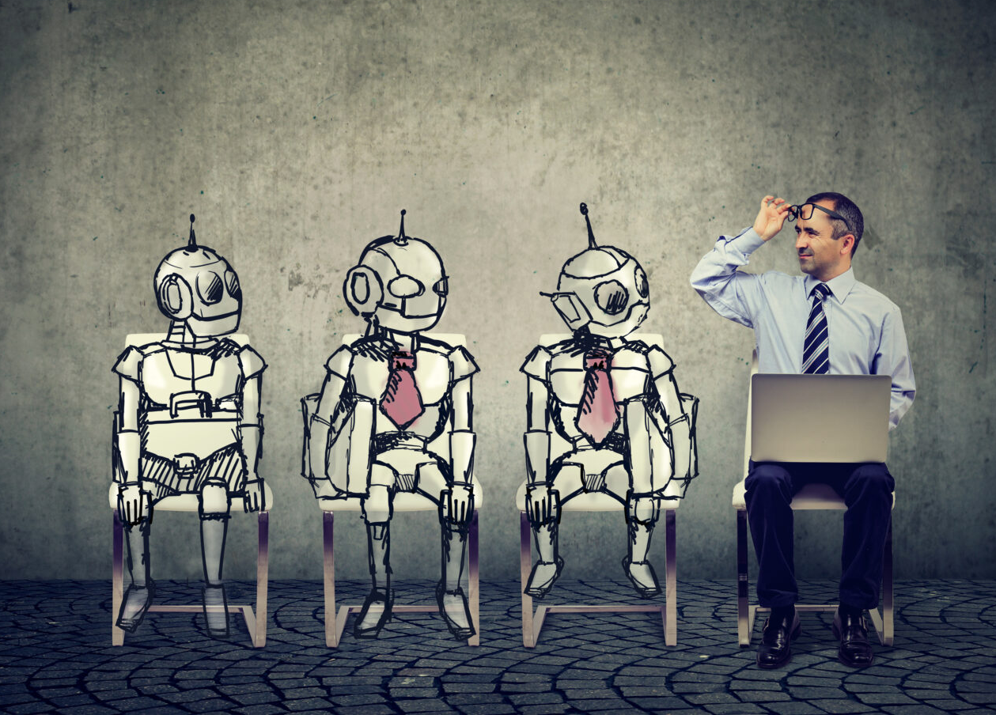
Applying Human Intelligence to Realize Sound Artificial Intelligence
Sterling Thomas, PhD
Chief Scientist,
U.S. Government Accountability Office
September 26, 2024

Slide 2
Overview: Artificial Intelligence and Machine Learning

Slide 3
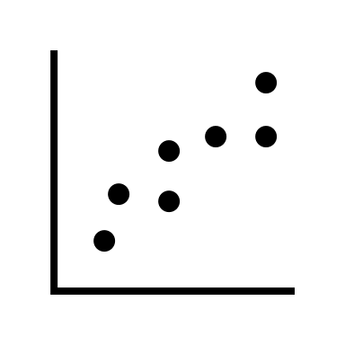
AI builds upon decades of analytics
Starting with…
Simple
Regression
Simple regression: describe a relationship between two variables by calculating the blue line
Example: temperature and rainfall

Slide 4
What constitutes AI?
Operations
Production Data
Digital Literacy
Training Data
Security
User Interface
Deep Learning Models
Questions AI could help with:
Machine Learning Models
What is in this picture? (computer vision)
Which product should we suggest to this customer? (recommendation)
What was said in this recording? (natural language processing)
What word comes next? (content generation)
Scalable Compute
Large Language Models

Slide 5
Outputs are probabilistic, not deterministic
Machine Learning 101
Yes, math is involved
It’s all about data
Easier to imagine operational use cases
Supervised Learning
Unsupervised Learning

Slide 6
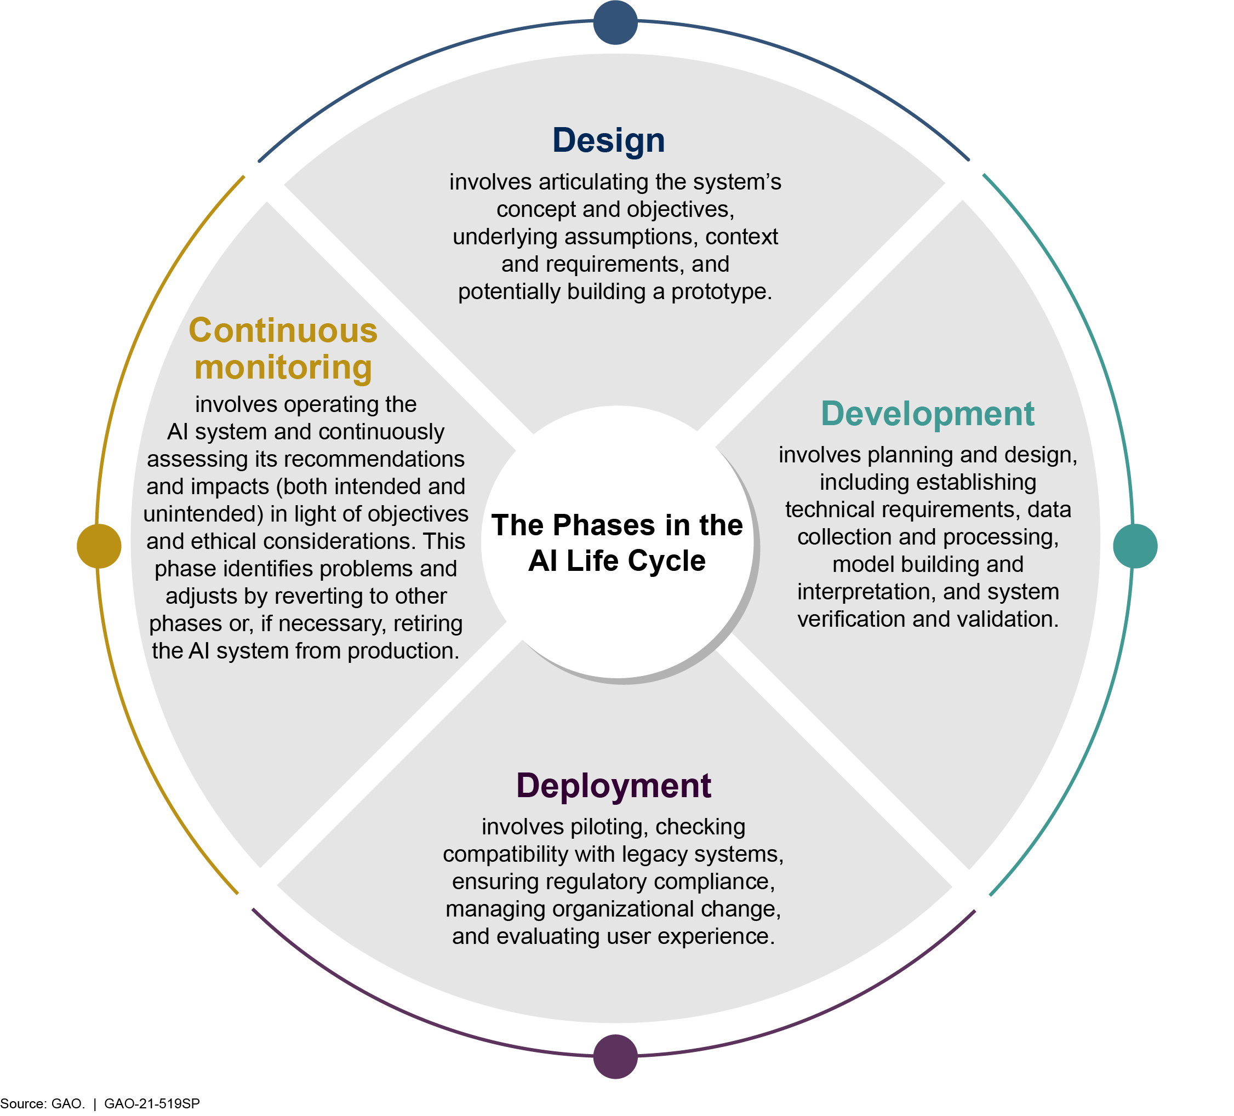
AI Life Cycle

Slide 7
Potential Harms of AI

Slide 8
AI feels different. We interact with AI differently than we do with other tech.

Slide 9
Selected risks of AI
AI systems can reinforce biases within training data
User interfaces are designed to hide potential for mistakes
Misleading content affects public discourse

Slide 10
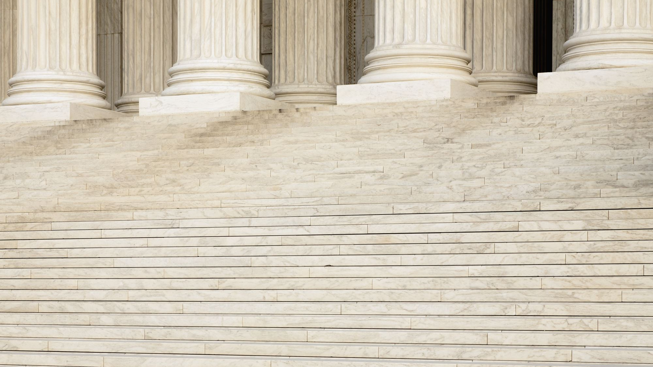
How we define AI can affect the potential for harm
Who is involved in defining and regulating AI?
Examples of definitions:
FY2019 NDAA
NYC AI-in-Hiring Law
European Union AI Act

Slide 11
Asking some human intelligence questions
Is there a simpler (non-AI) solution to the problem?
1
How do you decide
could vs. should?
2
Do you own AI or does AI own you?
3

Slide 12
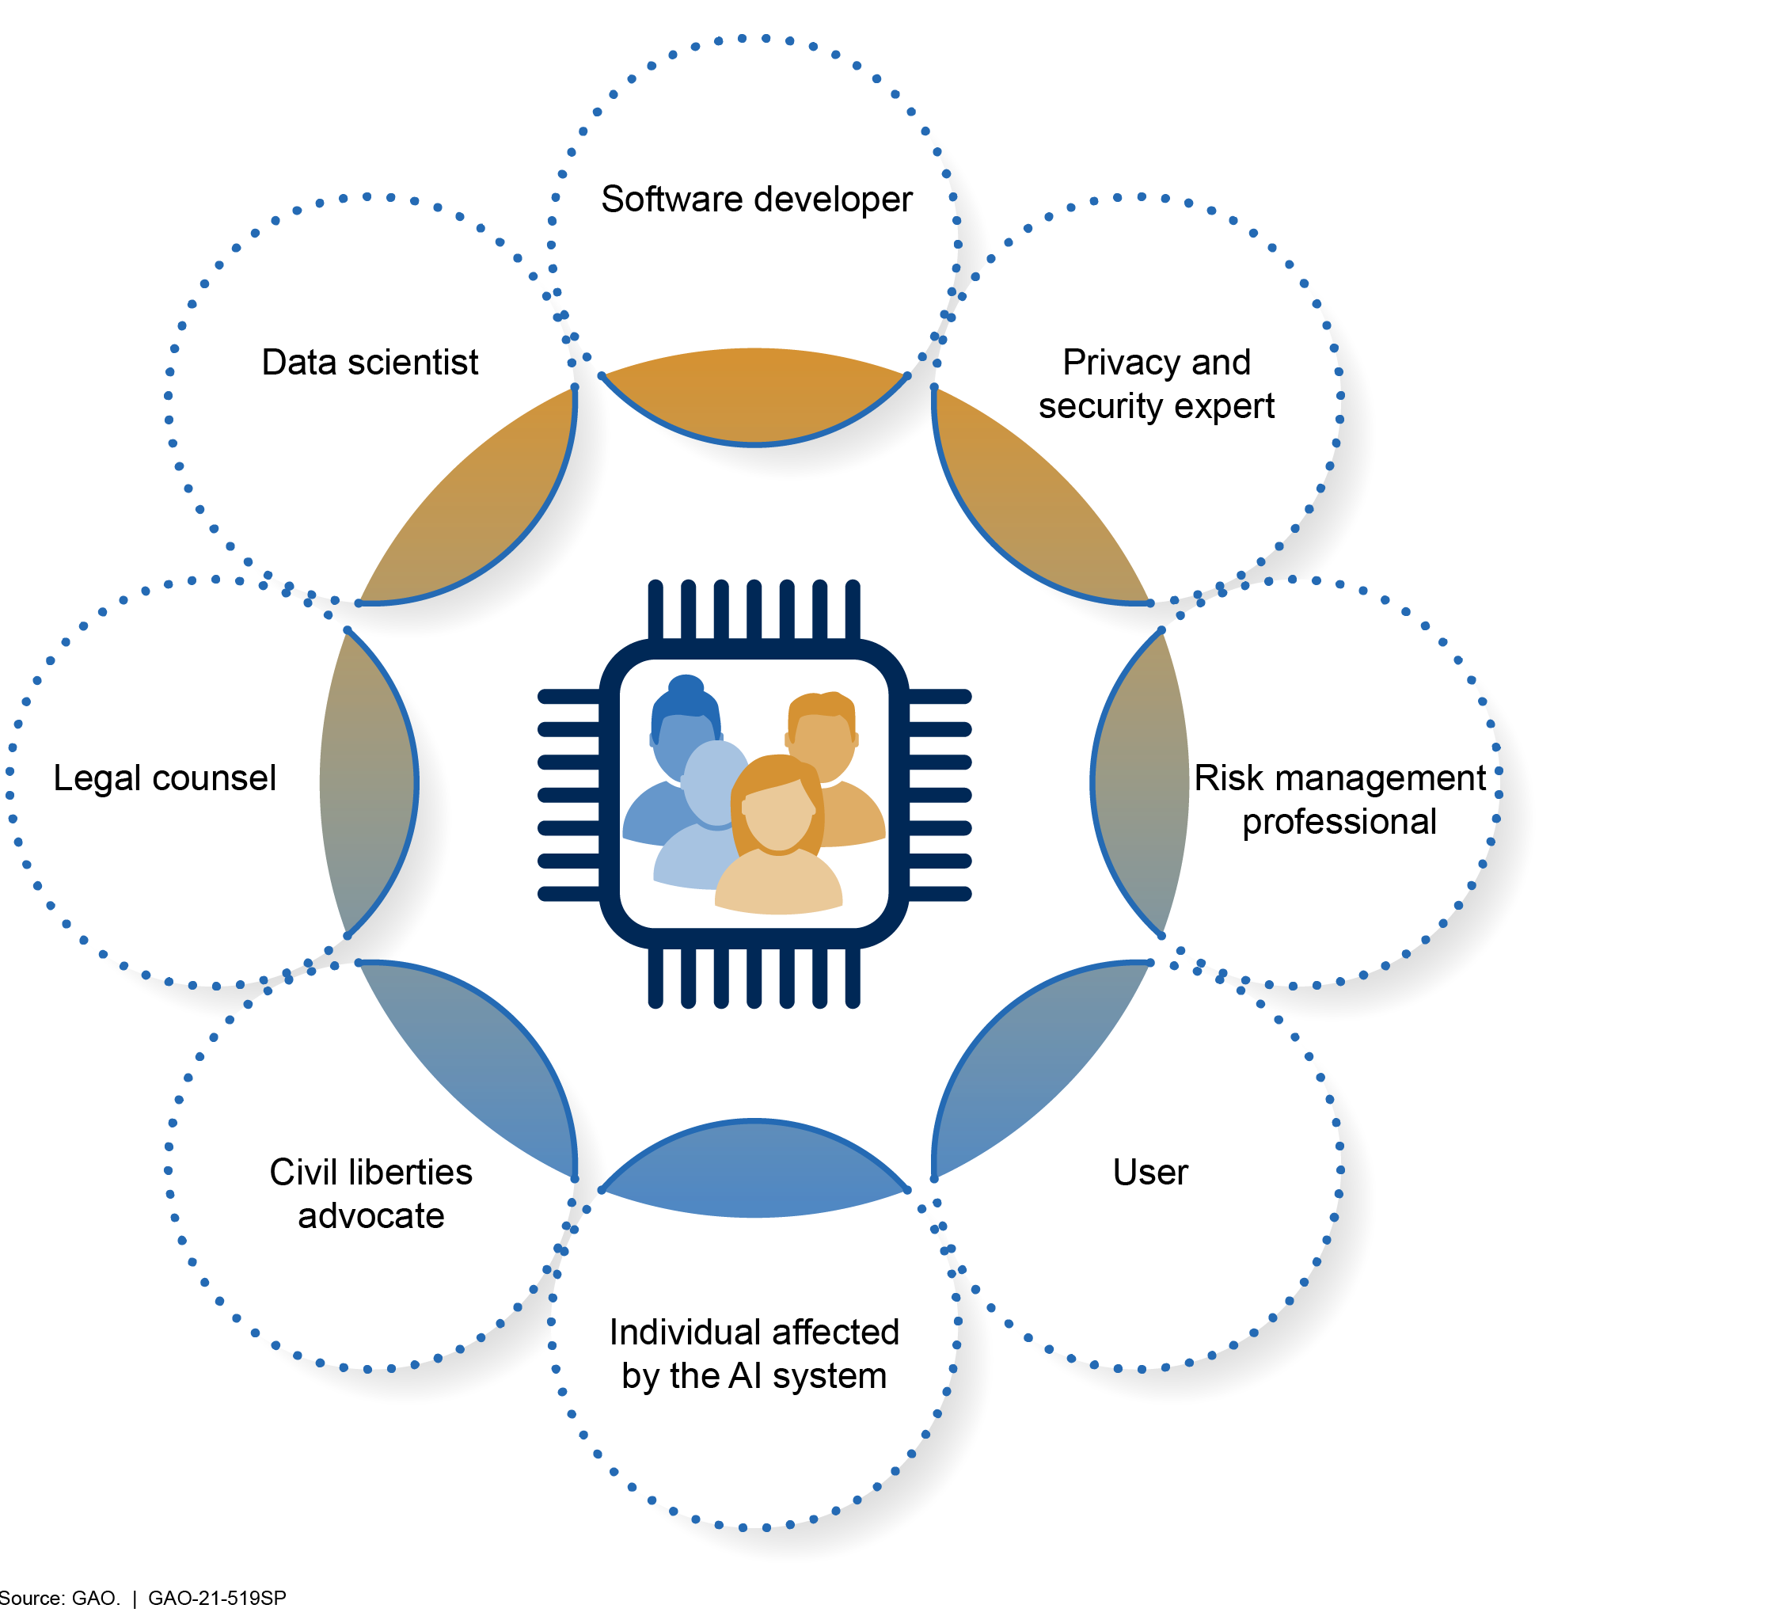
Checks and Balances

Slide 13
Beneficial uses of AI: GAO’s AI work and tools

Slide 14
Transformation
Modernization
Productivity Gains
GOVERNANCE
BUY vs. BUILD
DIGITAL LITERACY
REGULATORY COMPLIANCE
CYBERSECURITY
OPERATIONS & MAINTENANCE
EQUITY & ETHICS

Slide 15
NDAA
What do I have to do?
Federal Acquisition
Regulation
Executive Order 14110
AI Bill of Rights
Agency AI Strategy
NIST AI Risk Management Framework
GAO AI Accountability Framework
Federal Data Strategy
Technology Choices
Workforce
Partner Ecosystem
Zero Trust
Privacy Act
Civil Right Act

Slide 16
GAO’s Steadfast Focus on AI
Foresight
Including a technology assessment of AI for Natural Hazards Modeling (2023)
Oversight
Including the AI Accountability Framework (2021) and an audit of Homeland Security’s use of AI (2024)
Insight
Including Spotlights on generative AI, combatting deepfakes

Slide 17
Selected AI use cases
 | Triages IT help desk requests and answers internal GAO policy questions | Concept exploration
 | Enhances GAO auditing through use of extended reality glasses | Concept exploration
 | Provides automated responses to chat questions on published GAO work | Early-stage prototype
 | Summarizes qualitative responses from annual GAO Employee Experience Survey | Early-stage prototype
 | Monitors information about congressional committee calendars, press releases, and web contents | Early-stage prototype
 | Organizes large volumes of text, such as public comments from Regulations.gov | Late-stage prototype
 | Summarizes draft GAO legislative mandates | Late-stage prototype
 | Assists with copyediting according to GAO’s style guide | Late-stage prototype

Slide 18
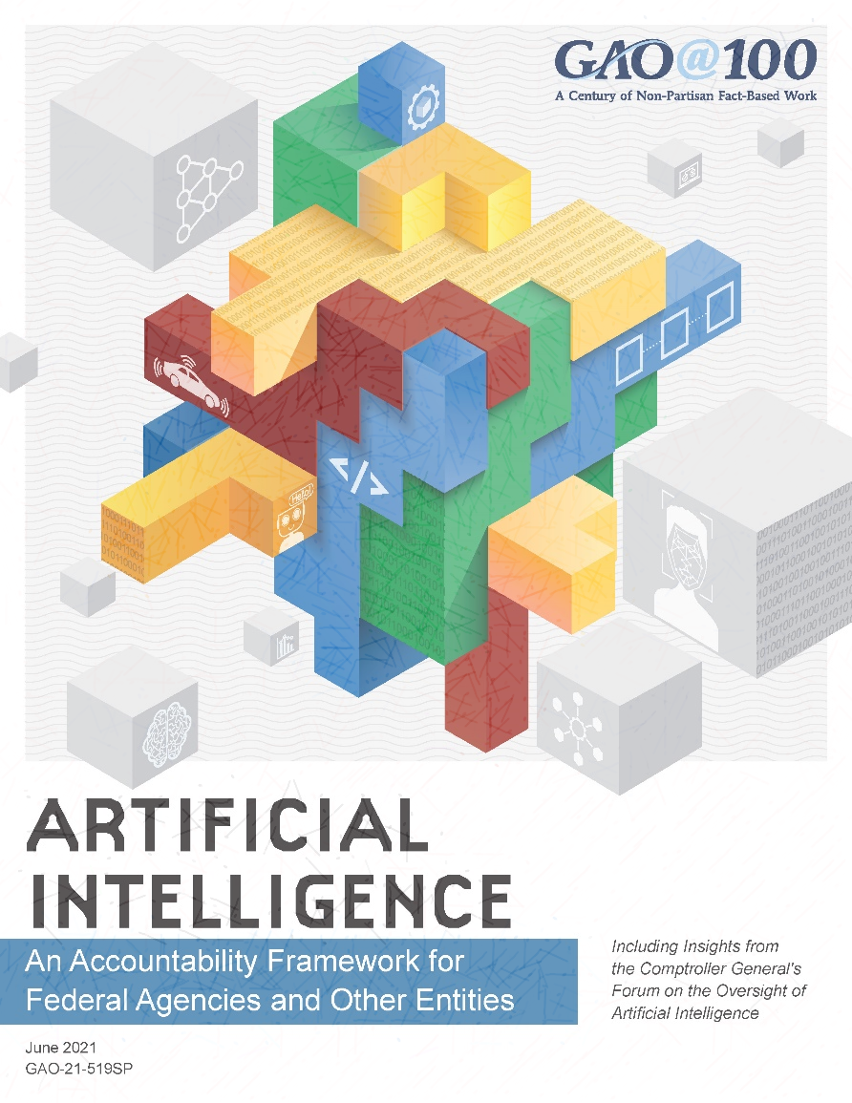
Trust but verify:
an effective approach

Slide 19
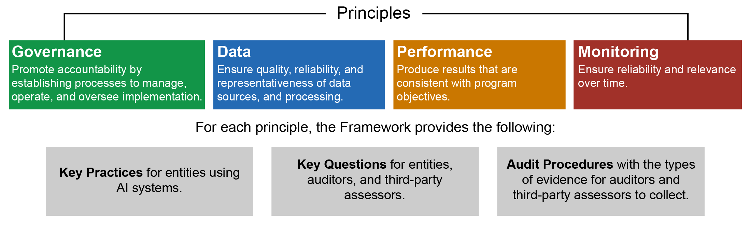
GAO AI Accountability Framework
Alignment with Yellow Book and Green Book standards

Slide 20
The Future of AI

Slide 21
Cognition
Data Sparsity
AI is here to stay but traversing a winding road ahead
Regulatory Frameworks
LAWS & OVERSIGHT
DISRUPTIONS
Instances of Use
Interoperability
CHIEF AI OFFICERS
Governance
Structure

Slide 22
Thank you

