Slide 1
Data Analytics IRL
How the MA OIG has used Data on Cases and Beyond

Slide 2
Massachusetts OIG
The data division
The mission of the OIG is to promote good government by preventing and detecting the misuse of public funds and public property. ​
Massachusetts Legislature funded a dedicated data division in FY23
Supports the OIG with Data acquisition, analysis, and visualization
Staff of five, including two data analysts and a data scientist
Leads data education and governance efforts

Slide 3
Why does the OIG incorporate data analytics?
Proactive approach to detect potential fraud, waste and/or abuse by developing data-driven investigative leads
Use technical capabilities (e.g., web and PDF scraping) to derive insights from unstructured data and decrease manual effort for staff
Identify high risk areas and uncover systemic issues and root causes by analyzing trends, anomalies and outliers
Apply statistical methodologies to reduce biases, improve reliability of results and forecast future trends

Slide 4
What types of analyses do we conduct?
Exploratory: reviewing data to further understand the context and identify potential analyses
Descriptive: generating statistics that summarize data and provide a baseline understanding of the content
Investigative: analyzing data with a specific investigative purpose in mind
Statistical: using techniques to identify relationships and trends in the data and test relationships
Predictive: using historical data to identify the likelihood of future events

Slide 5
What types of datasets do we use for investigations?
Vendor data
Line-item payments to and from the Commonwealth by vendors.
Used to identify risk factors for vendor fraud (e.g., payments slightly under procurement thresholds).
Payroll records
Hours and earnings for employees of the Commonwealth.
Used this to identify risk factors for payroll fraud (e.g., logging more than 24 hours in a day).
Investigations data
Data provided by an entity in an investigation.
This could be transaction data, call or message data, bank records, and everything in between.
Program data
Data on specific programs implemented by state agencies (e.g., state Medicaid program, SNAP program).
Publicly available data
A vital and often underutilized resource!
We use publicly available data on vendors debarred by state/federal entities, campaign contributions, etc.

Slide 6
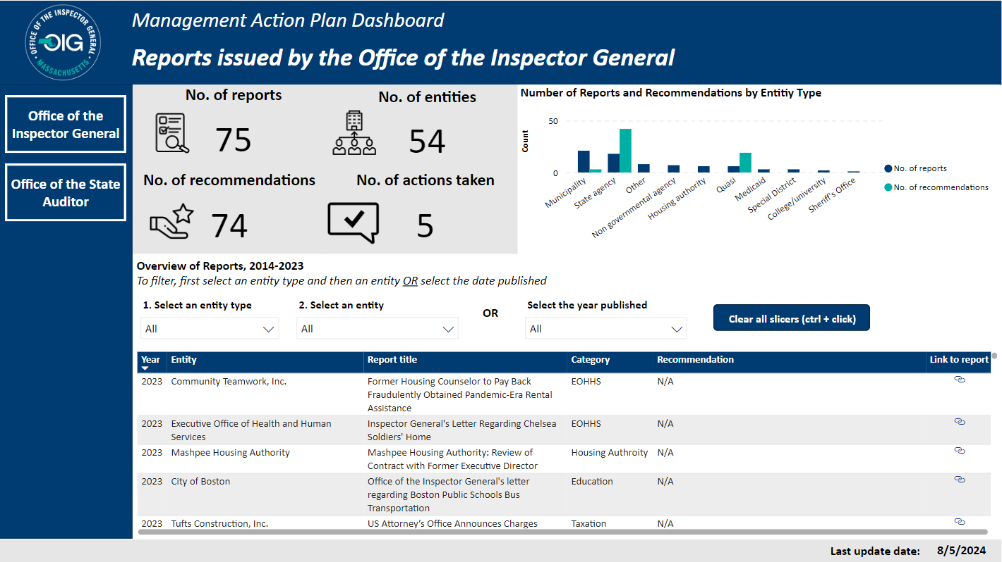
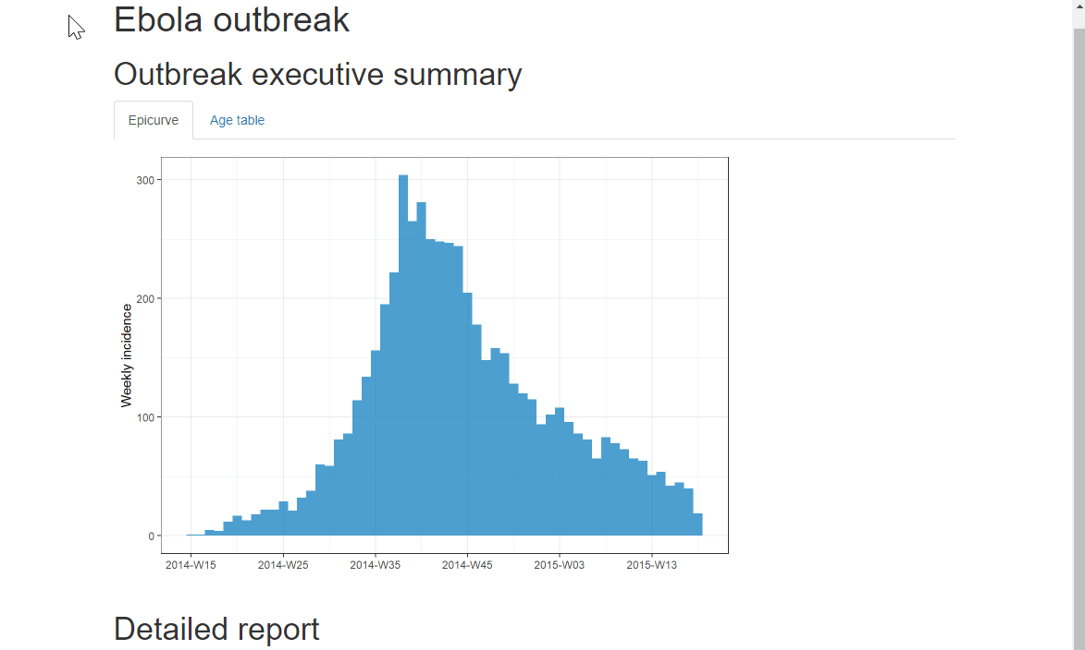
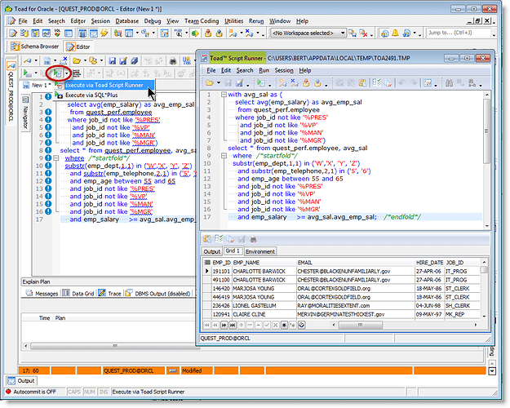
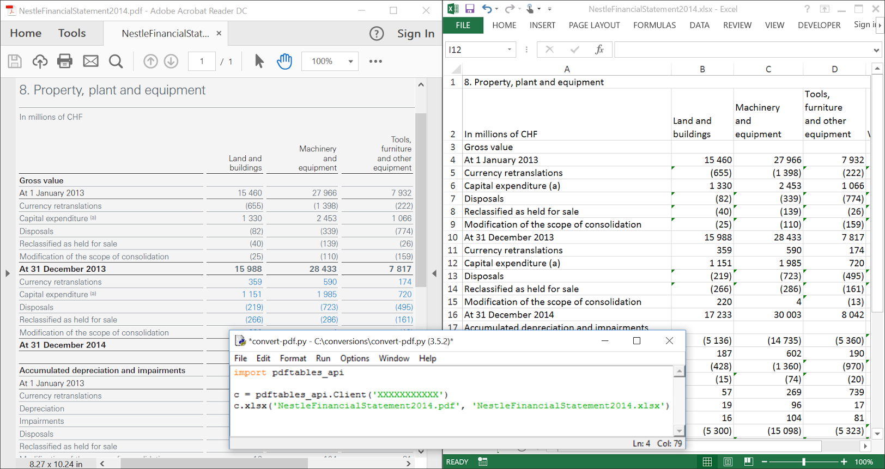
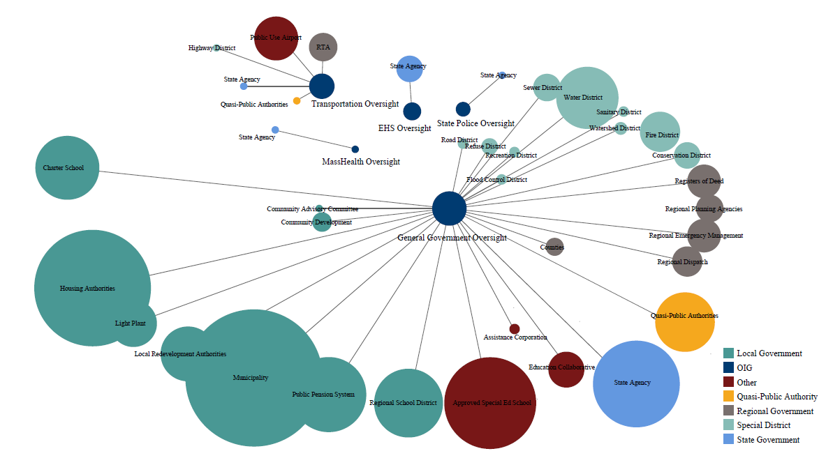
What type of work products do we create?
Dashboards
Data reports
Datasets from a warehouse query
Data extracts from documents
Visualizations

Slide 7
Why visualize data?
We create visualizations for internal and external reports, as well as to support investigations
Visualization allows for a quicker and deeper understanding of complex data​
It can help identify patterns and trends
It can lead to better comprehension and retention of information

Slide 8
Case Study: History of MCPPO class attendance
Context
The data division was asked to translate a narrative regarding class attendance for the Massachusetts Certified Public Purchasing Official program into a compelling visual for the OIG’s annual report.
The visual needed to show progress over time and identify key events or context that may have impacted attendance.
Goal
Create a simple, clean data visual that members of the public could consume without background context.

Slide 9
History of MCPPO class attendance – not great!
MCPPO started in 1997 with 554 attendees. The following year there were 623 attendees, and then 955 in 1999. In 2000, attendance surged to 1106, but then decreased to 997 in 2001. Over the next couple of years, there were fewer and fewer students, from 688 in 2002 to 293 in 2003. In 2004, attendance rose again to 490, and ten dropped to 200 in 2005. In 2006, it increased again to 500, then to 675 in 2007. In 2008 and 2009 there were 800 students, and then in 2010 there were 1000. In 2011 there were 900, and in 2012 it rose back up to 1000 again. Next, in 2013, there were 1500 students attending MCPPO classes. The following year, this amount decreased to 1300. The number rose back up to 1500 in 2015, and then to 1600 students in 2016. In 2017, the number of students climbed to 1900. Finally, in 2018, it rose by another 200 to 2100 students.
(Information collected from OIG Annual Reports at https://www.mass.gov/service-details/oig-annual-reports)

Slide 10
History of MCPPO class attendance - slightly better!
Year | Attendance
1997 | 554
1998 | 623
1999 | 955
2000 | 1106
2001 | 997
2002 | 688
2003 | 293
2004 | 490
2005 | 400
2006 | 500
2007 | 675
2008 | 800
2009 | 800
2010 | 1000
2011 | 900
2012 | 1000
2013 | 1500
2014 | 1300
2015 | 1500
2016 | 1600
2017 | 1900
2018 | 2100

Slide 11
History of MCPPO class attendance – getting there!

Slide 12
History of MCPPO class attendance – almost there!
Pandemic expands online class offerings
MSBA regulation requires those in charge of School building project to be MCPPO certified

Slide 13
History of MCPPO class attendance – bingo!
Pandemic expands online class offerings
MSBA regulation requires those in charge of School building project to be MCPPO certified
Administration
Robert A. Cerasoli
Gregory W. Sullivan
Glenn A. Cunha

Slide 14
Case Study: Budget Testimony
Context
The data division was asked to support the Inspector General’s testimony regarding the OIG’s FY24 and FY25 budget.
These hearings occur over a series of non-consecutive days. Agency heads testify before the House and Senate Committees on Ways and Means.
In this context, every agency is asking for resources, and the hearings are long.
Goal
Demonstrate the discrepancy between the OIG’s oversight responsibilities and its overall budget in a compelling way.

Slide 15
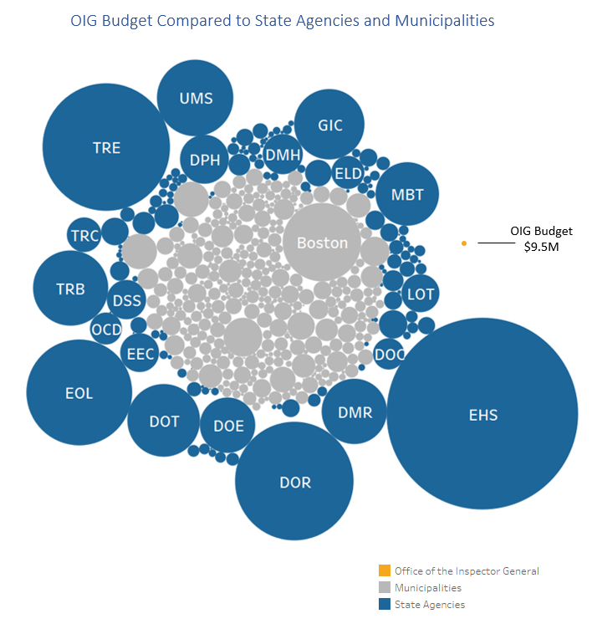
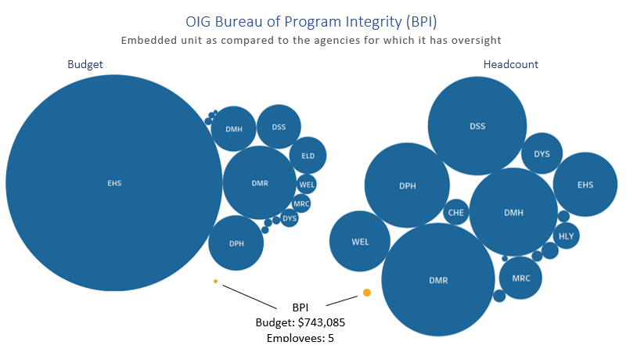
Case Study: Budget Testimony
Embedded Units

Slide 16
Case Study: Budget Testimony

Slide 17
Case study: network analysis
Context
During an investigation, an investigator may want to see relationships between different people or entities.
For example, suppose you are reviewing a potential housing benefits scam conducted by multiple individuals. You may want to see:
All individuals that used the same telephone number.
Whether multiple individuals shared a bank account number
Goal
Combine various data points and create a network diagram to visualize these potential relationships between actors.

Slide 18
Case Study: Network analysis
Shared by AH1 and SP2
Shares an SSN and unsecured loan with Account Holder 1
Shares a phone and SSN with Account Holder 3
Same address as AH 1 and AH3
Same SSN as SP2
Same Phone as A1 and SP2
Shared by AH1, AH2, AH3

Slide 19
Case Study: Healthcare report
Context
The OIG’s Healthcare Division (HCD) planned a review of MassHealth’s Applied Behavior Analysis (ABA) Program, which provides treatment to eligible children diagnosed with autism spectrum disorder (ASD).
HCD’s main areas of interest included provider compliance with regulations regarding appropriately supervised ABA care and billing irregularities (e.g., billing more than 24 hours in a day).
Goal
Conduct an outlier analysis on Medicaid claims data to identify providers with supervision or billing irregularities.

Slide 20
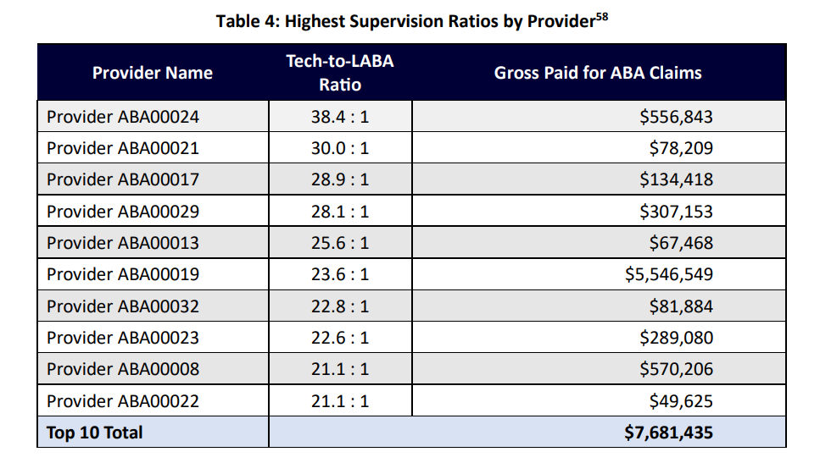
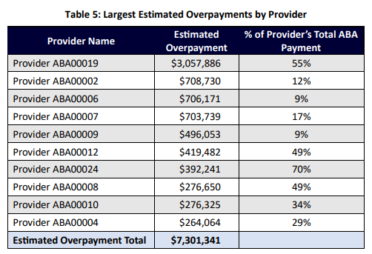
Outlier analysis 1 – outlier provider supervision ratios
The OIG’s outlier analysis included only those MassHealth ABA providers who provided services to at least five MassHealth members during the review period (562 total providers).
Out of the 562 providers, the OIG identified 108 ABA providers with claims submitted for at least five MassHealth members who had BT-to-LABA time ratios exceeding the 10:1 ratio.
From the 108 ABA providers with claims indicating excessive unsupervised time, the OIG identified the top 10 ABA providers.

Slide 21
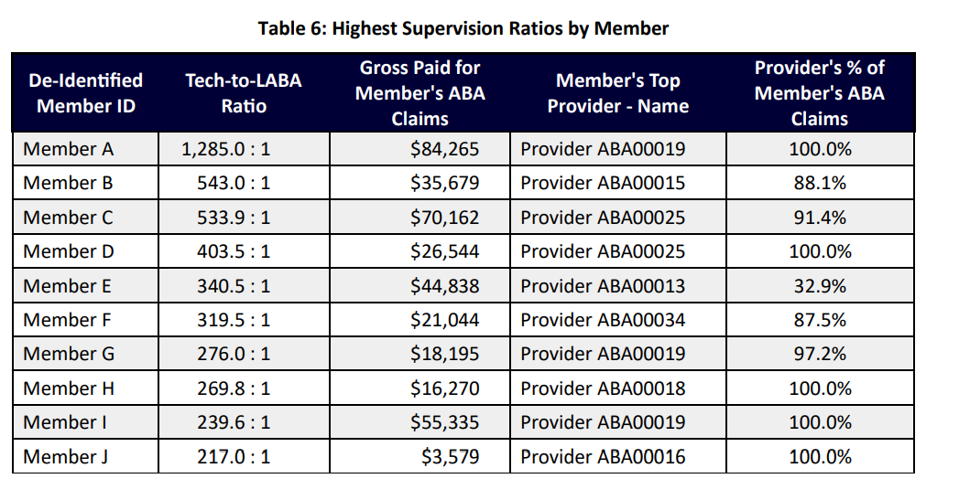
Outlier analysis 2 – outlier member supervision ratios
The OIG identified providers who submitted claims exceeding the 10:1 tech-to-LABA ratio across all MassHealth ABA providers.
In the aggregate, ABA providers exceeded the supervision ratio for 1,831 MassHealth members.
The table identifies the top 10 members and their providers who exceeded the required BT-to-LABA supervision ratio.

Slide 22
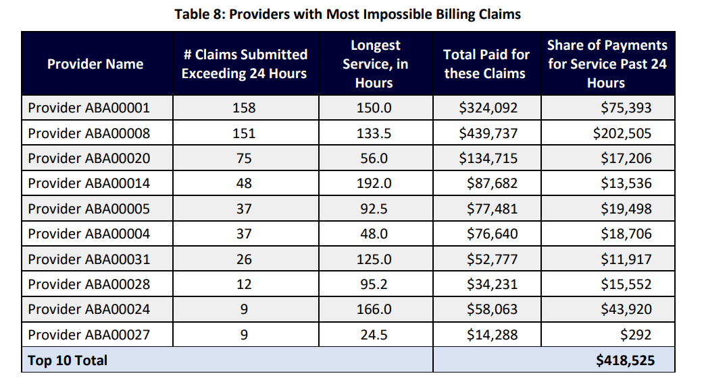
Outlier analysis 3 – impossible billing claims
The OIG identified 627 “impossible billing” claims with more than 24 hours of ABA services rendered to a member on a given service date, based on the units submitted.
MassHealth paid $1,368,929 for these claims, with $439,632 attributable to the share of claims that passed the 24-hour mark.

Slide 23
Questions?

