Slide 1



STATE BOARD OF ACCOUNTS

Slide 2
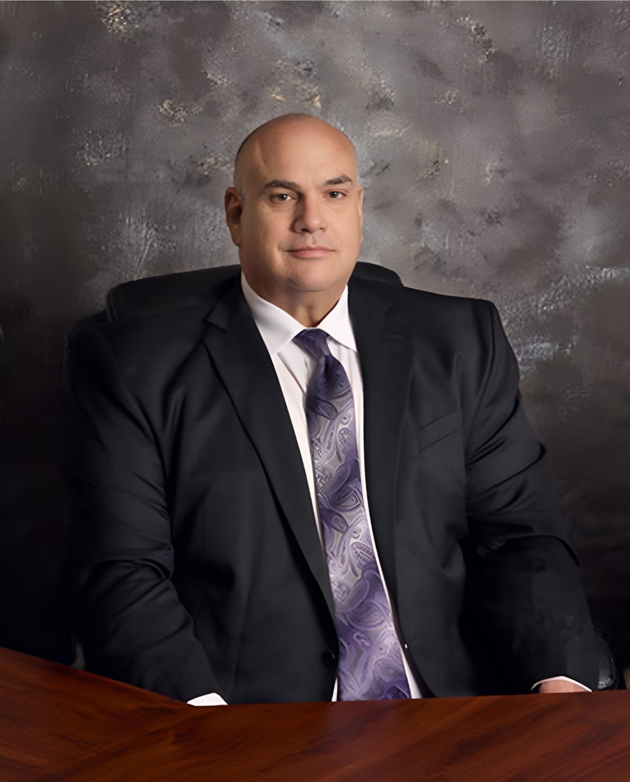

PAUL D. JOYCE, CPA STATE EXAMINER
Indiana’s State Examiner and the agency head for the State Board of Accounts, Paul Joyce coordinates and manages the post-audits and examinations of over 4,000 state and local governmental entities in Indiana.

Slide 3


Units
  Towns
  Cities
  County Governments
  Townships
  Non for profits receiving government funds
  School Corporations

Slide 4

Misfeasance – Not performing a lawful act in a proper manner
Nonfeasance – An omission to perform a duty or a total neglect to perform a duty.
Malfeasance – Doing an act Wholly wrong.

Slide 5

Special Investigations
Separate from the Audit teams
Investigate allegations of malfeasance
Northern Team/Southern Team – 13 investigators
Coordinate investigations with local/state/federal law enforcement
Produce charge reports that are enforced by the Attorney General’s Office
Assist in criminal prosecutions

Slide 6
How we receive complaints
Government unit referral
Citizen complaints
Law enforcement referral
Audit ream referral

Slide 7


Assessment vs. Investigation
“I heard there’s a Town Board meeting tonight”
Rumer Mill
“The town board is going to approve a 300% raise for themselves tonight”

Slide 8
Possible Outcomes of a Special Investigation
Unfounded – No charge, no report
Management Letter
Compliance Report
Charge Report
Charge Report with Criminal Prosecution

Slide 9
Fairfield Township Trustee
Malfeasance included:
Personal expenditures
Salary overpayment
Selling personal property to the township without filing a conflict-of-interest statement

Slide 10
Fraudulent Receipt

Slide 11
Real Receipt

Slide 12

$17,787 of Self-Help Materials

Slide 13

Took her entire staff to a “team building event”

Slide 14
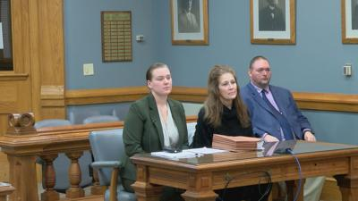
Total loss to the unit was $53,827.51
Coles was sentenced to four years

Slide 15
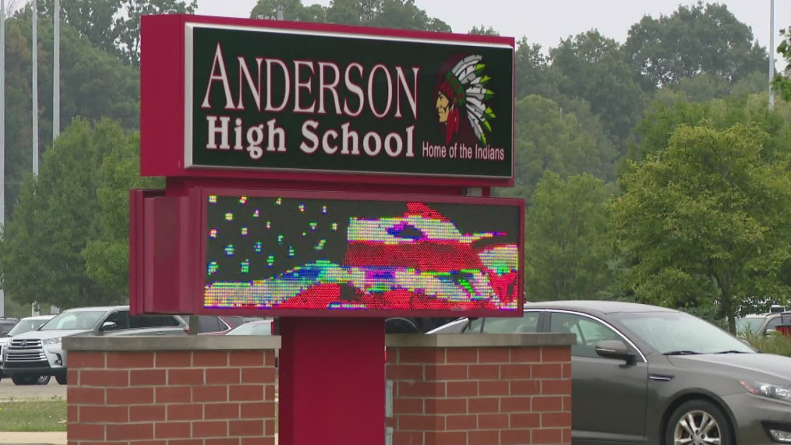
Anderson School Corporation Bookkeeper

Slide 16
Carla Burke
One of Burke’s duties was to pay school vendors.
Burke would submit vouchers for payment and once approved, she would send the payment to the vendor.
Burke would receive a cashiers check to provide to the vendor via email.
Burke would then print the check and provide it to the vendor.

Slide 17
Carla Burke
Burke began submitting fraudulent voucher claims
Once Burke received the check via email, she had the ability to change the vendor’s name to her name, print the check and then change it back to the vendor’s name.
Burke did this 312 times over a five-year period and was successful in stealing $976,773.29.
Federally indicted on multiple counts of wire fraud and was sentenced to 28 months incarceration.

Slide 18
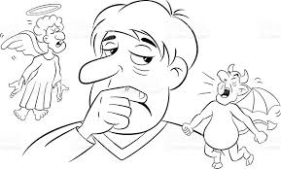
Reasons a good person may resort to theft
Expenses related to an Accident or Illness involving a Family Member
Spouse’s loss of job
Debt
Passed up for a truly deserved raise
Just “borrowing” with intent to pay back the amount taken
Child College Expenses

Slide 19

Darker Reasons often unknown to co-workers
Drugs
Gambling Debts or Other Uncontrollable Habits
Blackmail
Greed
Irrational desire to provide everything possible for Grandchildren or Family

Slide 20
What’s the number one reason people steal?

Slide 21
Because they can!

Slide 22




THANK YOU
OFFICE
Indianapolis, In
(317)694-0721
Ewheele@sboa.in.gov

